Slide 1


Don Bosco Institute of Technology
Kurla, Mumbai, 400070
Academic Year: 2024-25
Department of Computer Engineering
Subject: Cloud Computing Laboratory
“End-to-End Azure ETL Pipeline: HTTP to Power BI using Data Factory, Databricks & Medallion Architecture”
15 | Ria Dcosta
16 | Sasha Dcosta
06 | Harshavardhan B.

Slide 2
Introduction/Background
In today’s data-driven world, organizations deal with massive volumes of data from multiple sources. Building efficient data pipelines is essential for extracting insights and making informed business decisions. This project showcases a complete end-to-end ETL pipeline using Microsoft Azure services—from raw data ingestion to visual analytics. Leveraging tools like Azure Data Factory, Azure Databricks, Data Lake Storage, and Power BI, this pipeline demonstrates how cloud technologies simplify and scale data engineering workflows for real-world applications.

Slide 3
Problem Statement
Organizations often struggle to handle large volumes of raw, unstructured data from various sources. Traditional ETL processes are often manual, slow, and not scalable for handling large datasets. There is a need for an automated, cloud-based solution to efficiently ingest, transform, and visualize data using modern tools like Azure Data Factory, Databricks, and Power BI.

Slide 4
Project Phases
🔹Phase 1: Problem Statement Identification
Defined the business problem and need for a scalable ETL pipeline using Azure cloud services.
🔹 Phase 2: Data Pipeline Development
Built the ETL process using Azure Data Factory for ingestion, Azure Databricks for transformation, and implemented Medallion Architecture.
🔹 Phase 3: Cloud Deployment
Deployed services on Azure including Storage Account, Data Factory, Databricks Workspace, and established seamless integration.
🔹 Phase 4: Visualization & Reporting
Connected cleaned and structured data to Power BI for dashboard creation and business insights

Slide 5
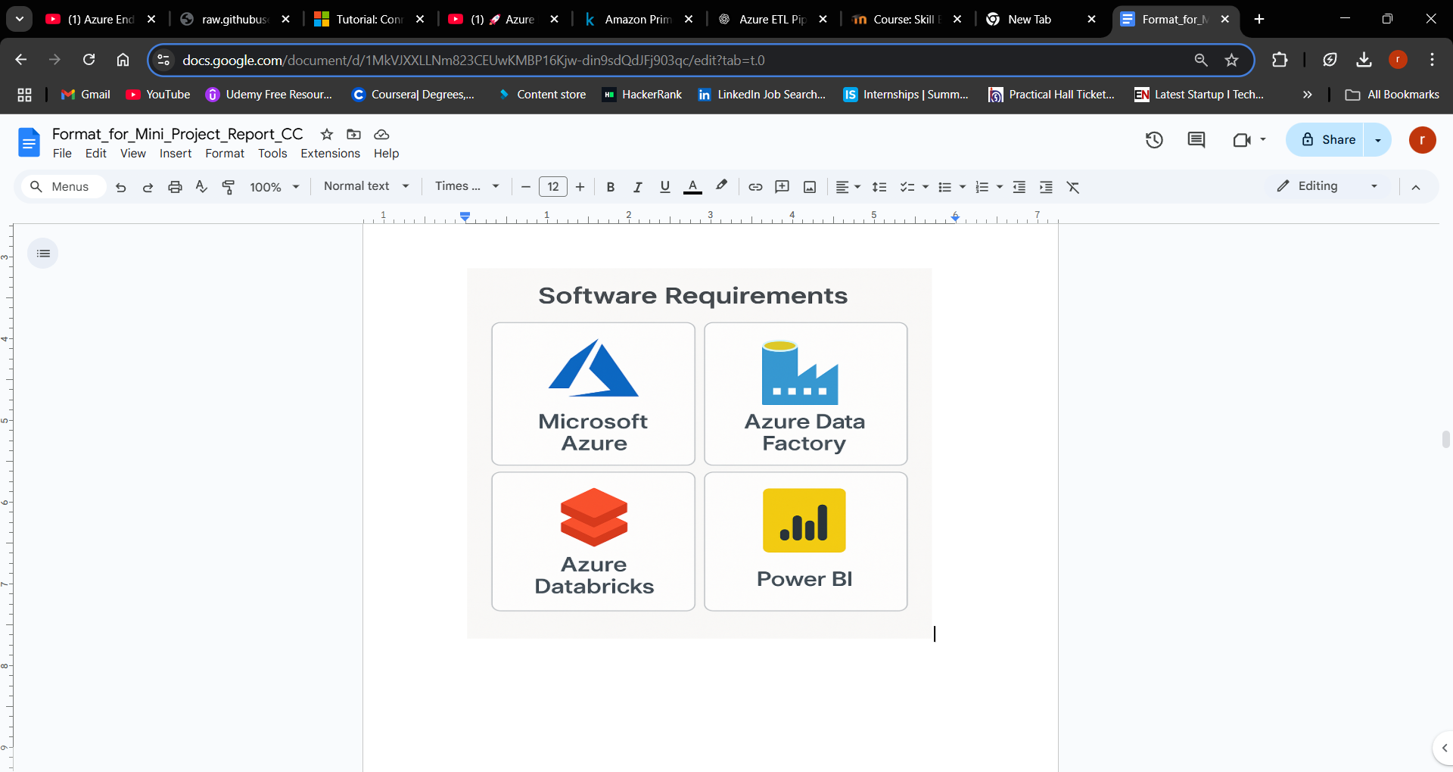
Technologies used

Slide 6
Cloud features/ components used
🔹 Azure Data Factory
Orchestrates and automates data workflows through pipelines and copy activities.
🔹 Azure Data Lake Storage Gen2 (ADLS)
Highly scalable cloud storage optimized for big data analytics; supports hierarchical namespaces.
🔹 Azure Databricks
Apache Spark-based platform for data engineering and machine learning; used for data transformation using PySpark.
🔹 Power BI
Cloud-based business intelligence tool used to visualize curated data and generate insights.
🔹 Azure Resource Group
Logical container that holds related Azure resources, ensuring organized deployment and management.
🔹 Azure Subscription
Allows access to Azure services with usage tracking and billing.
🔹 Access Control (IAM)
Manages user roles and permissions to secure access to cloud resources.

Slide 7
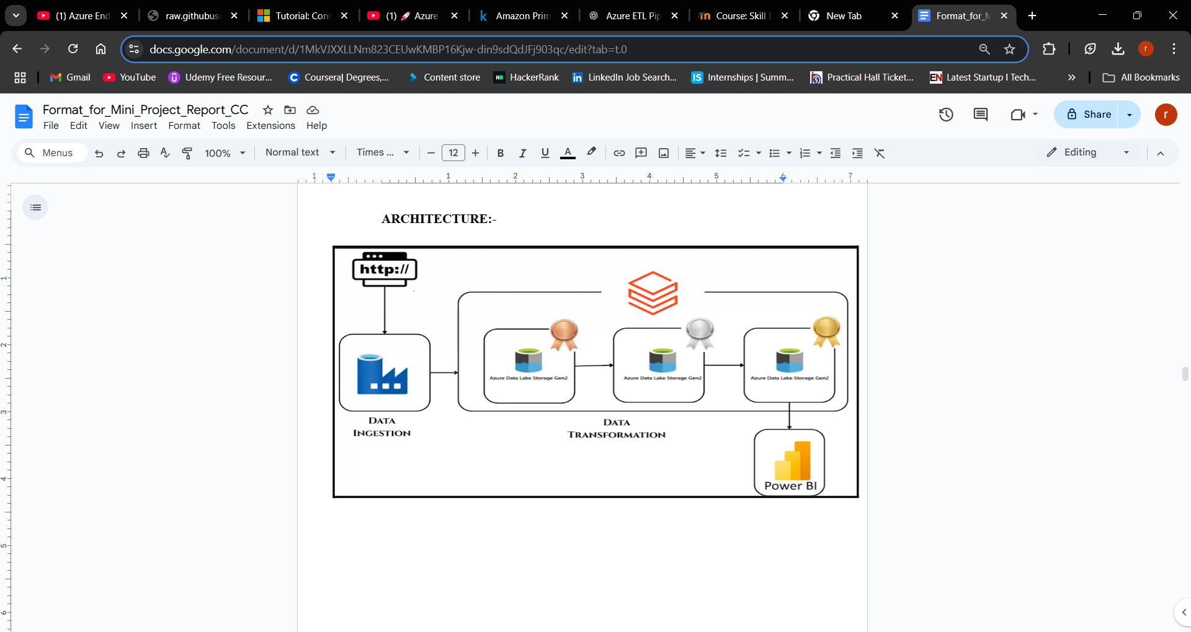
ARCHITECTURE

Slide 8
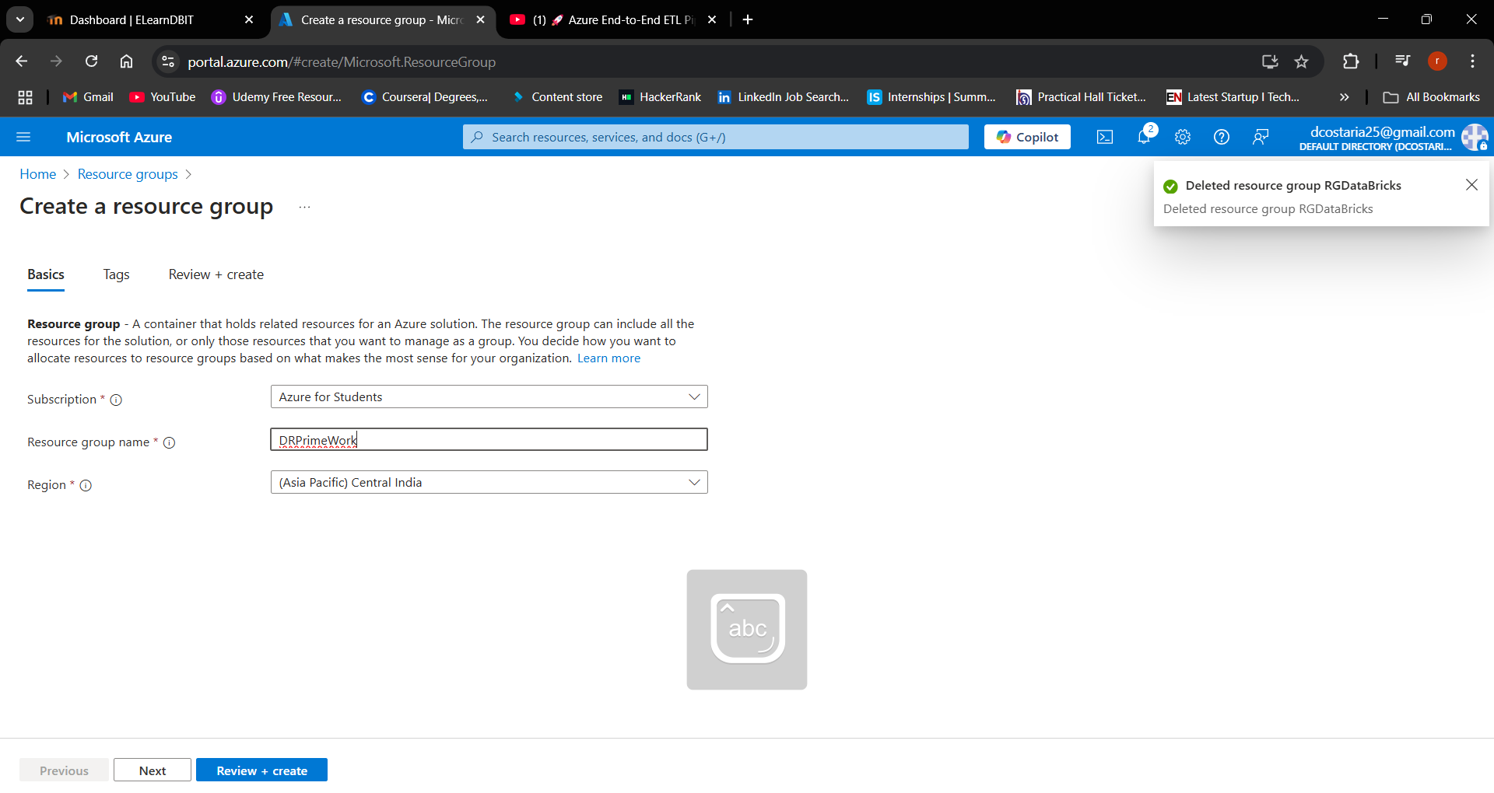
Step 1) Resource group creation

Slide 9
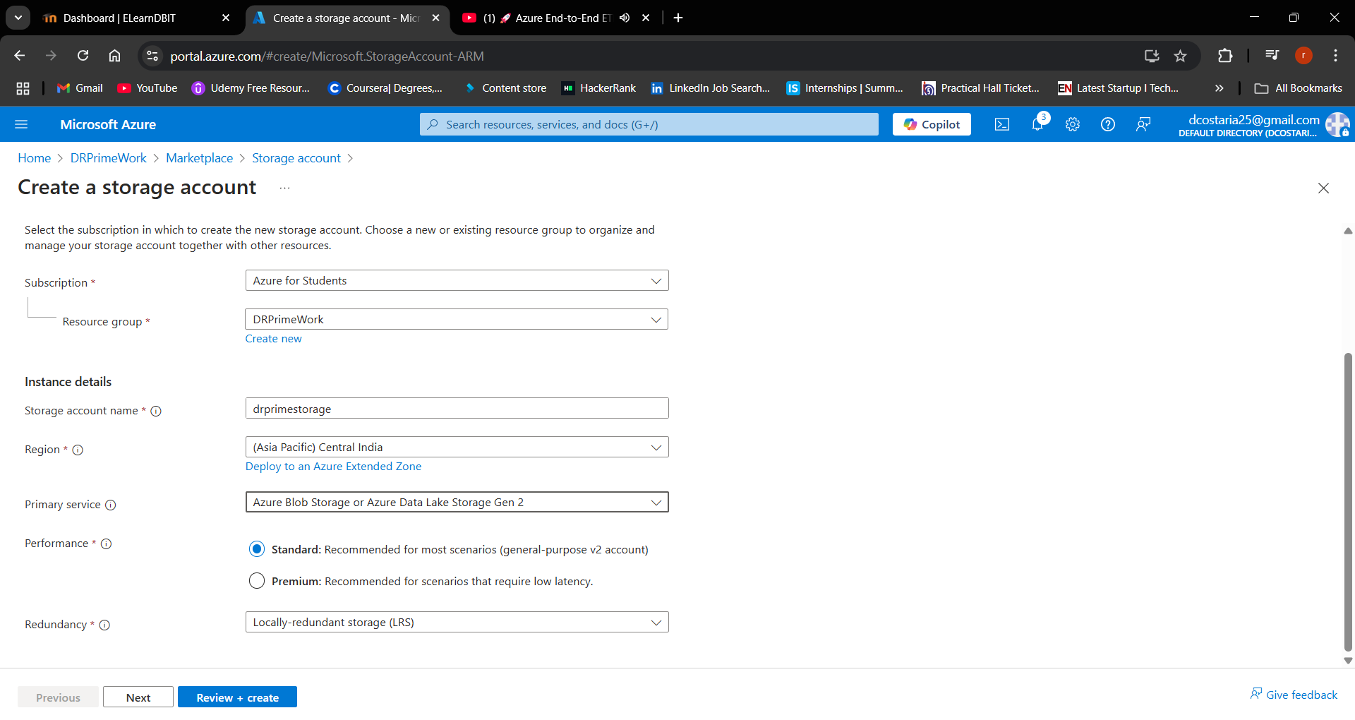
Step 2)Storage Account Creation

Slide 10
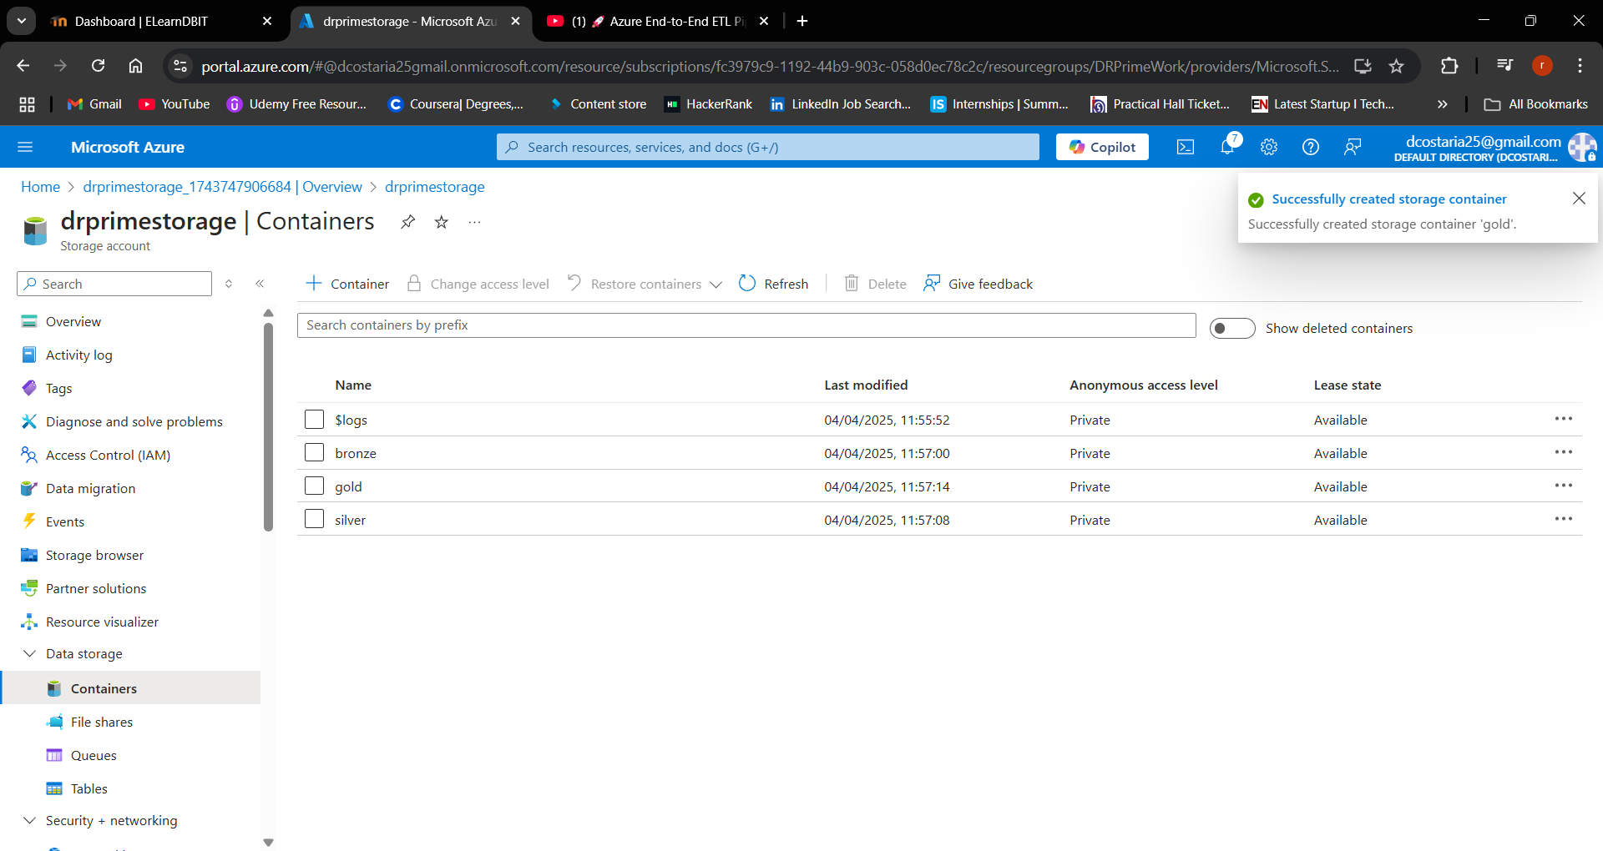
Step 2-1)Adding Container in Storage Account

Slide 11
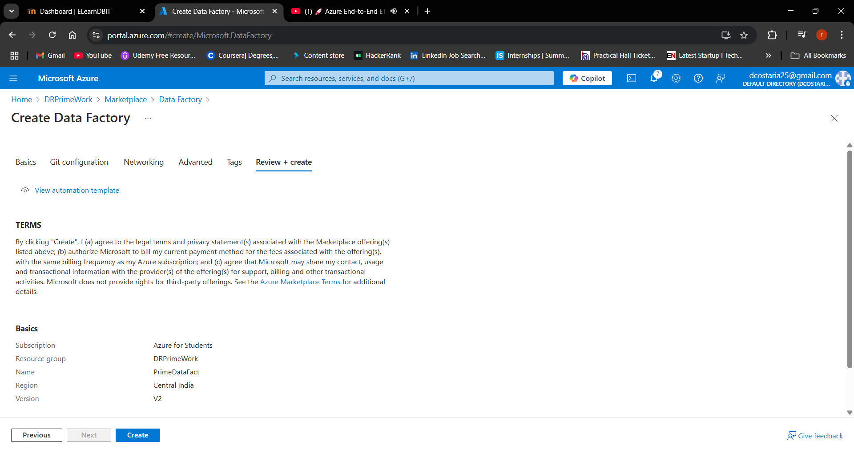
Step 3) Data Factory Creation

Slide 12
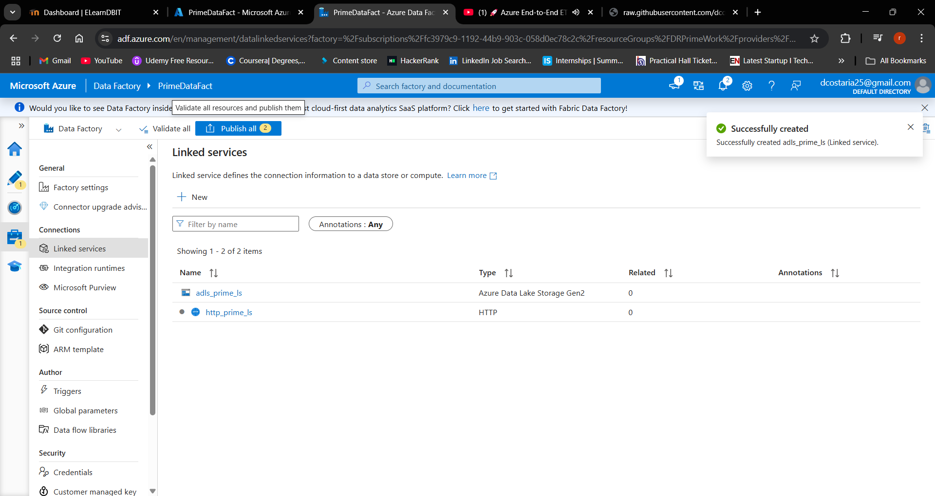
Step 3-1) -In Manage Create Http and Azure data lake gen 2 Links

Slide 13
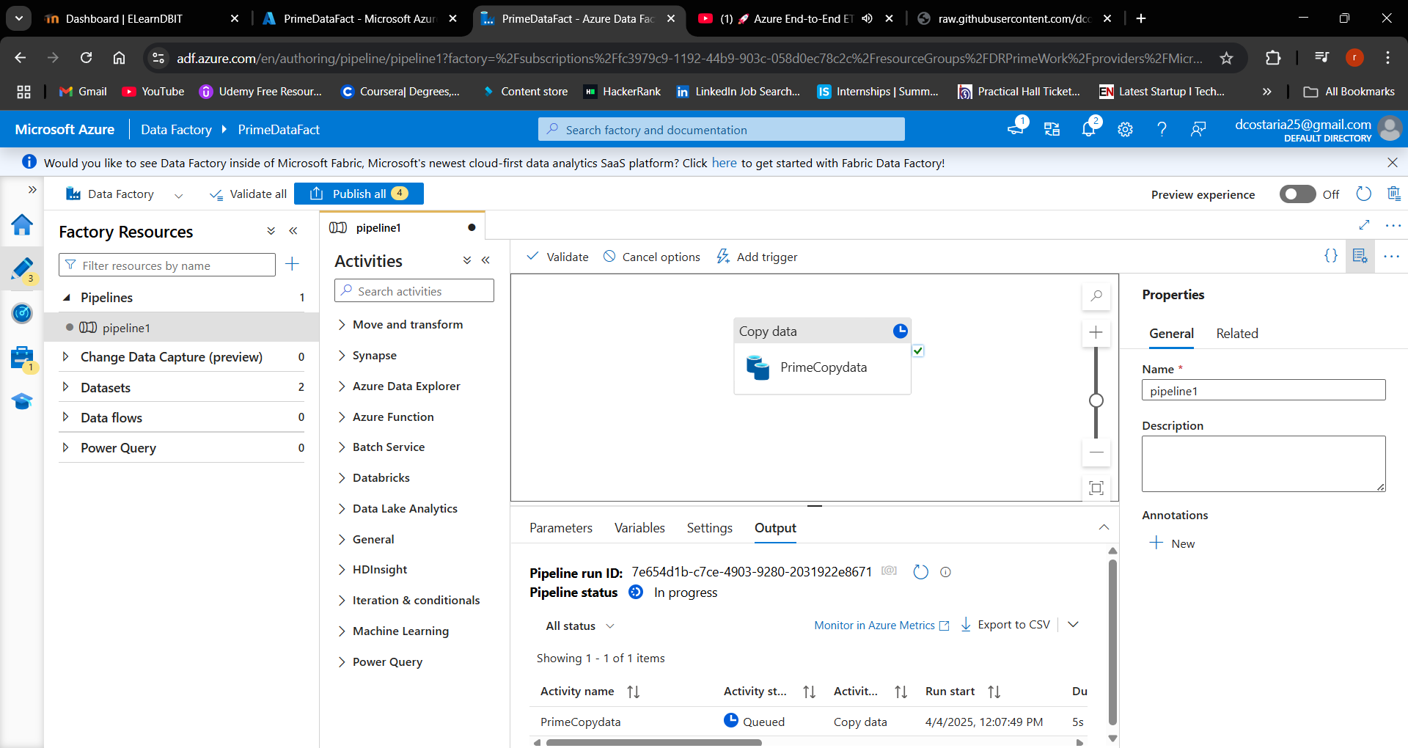
Step 4) Azure Data Factory - Copy Activity Creation

Slide 14
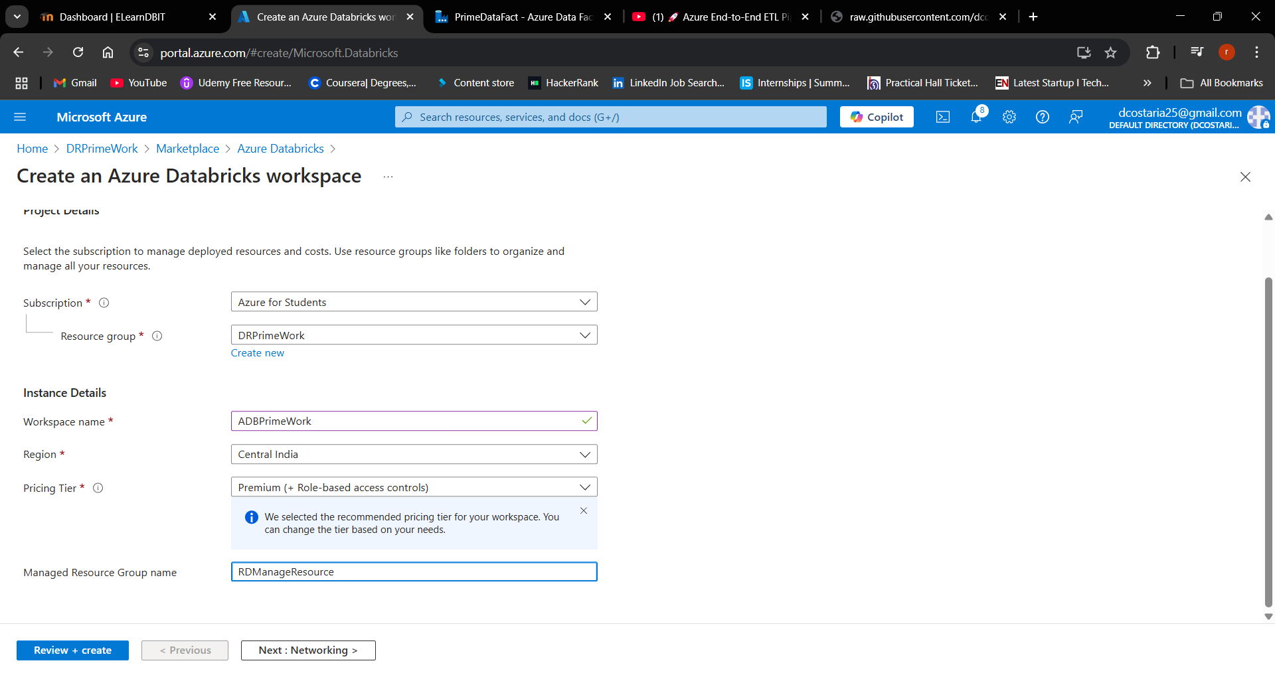
Step 5) Azure DataBricks Creation

Slide 15
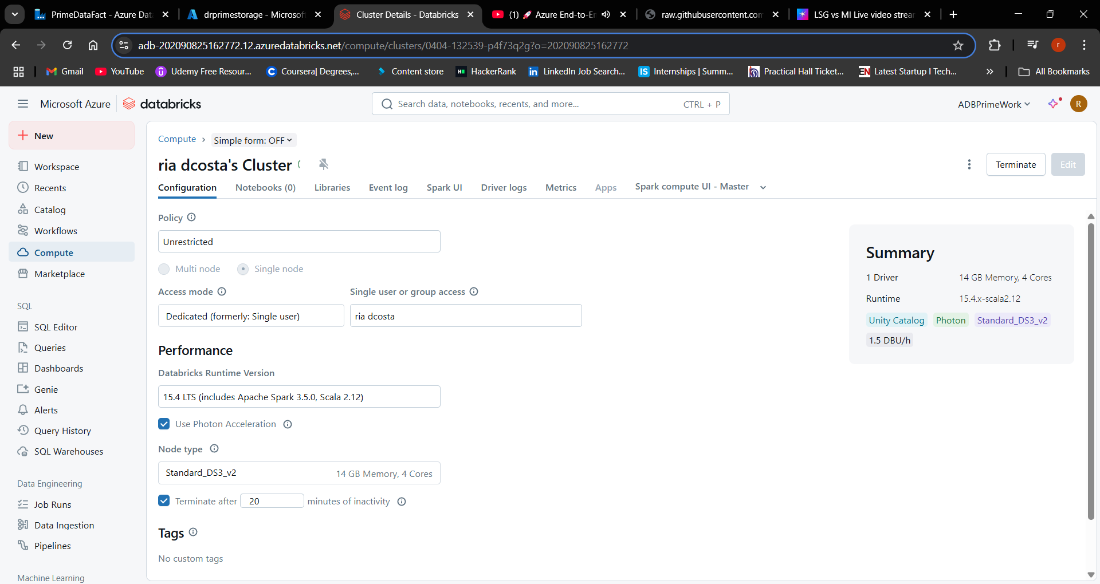
Step 6) Azure DataBricks Cluster Creation

Slide 16
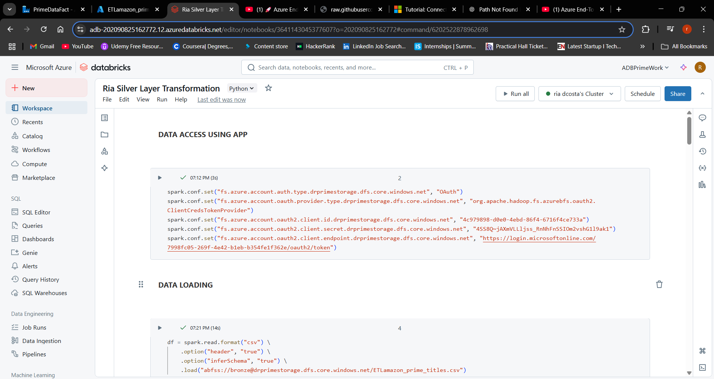
Step 7) Azure Databricks - Silver Layer - Cleaning & Transformations

Slide 17
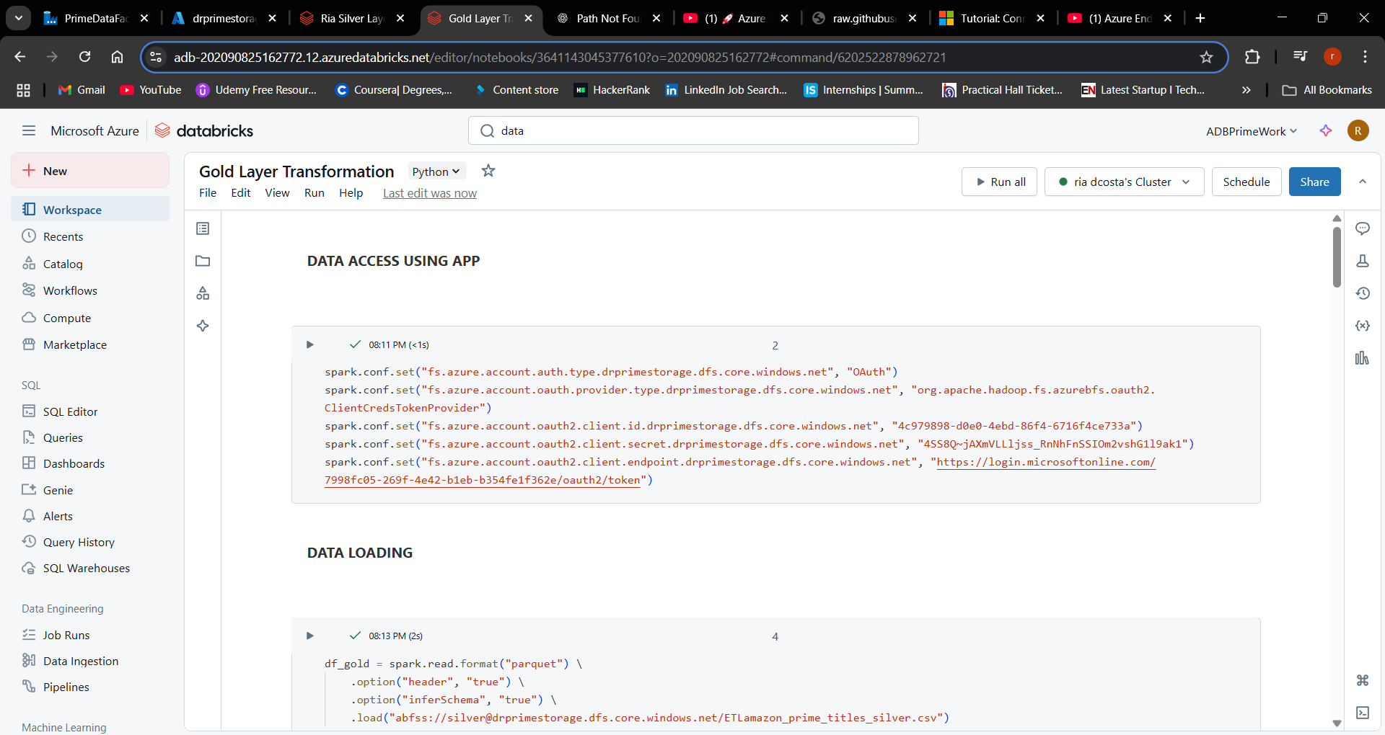
Step 8) Azure Databricks - Gold Layer - Transformations

Slide 18
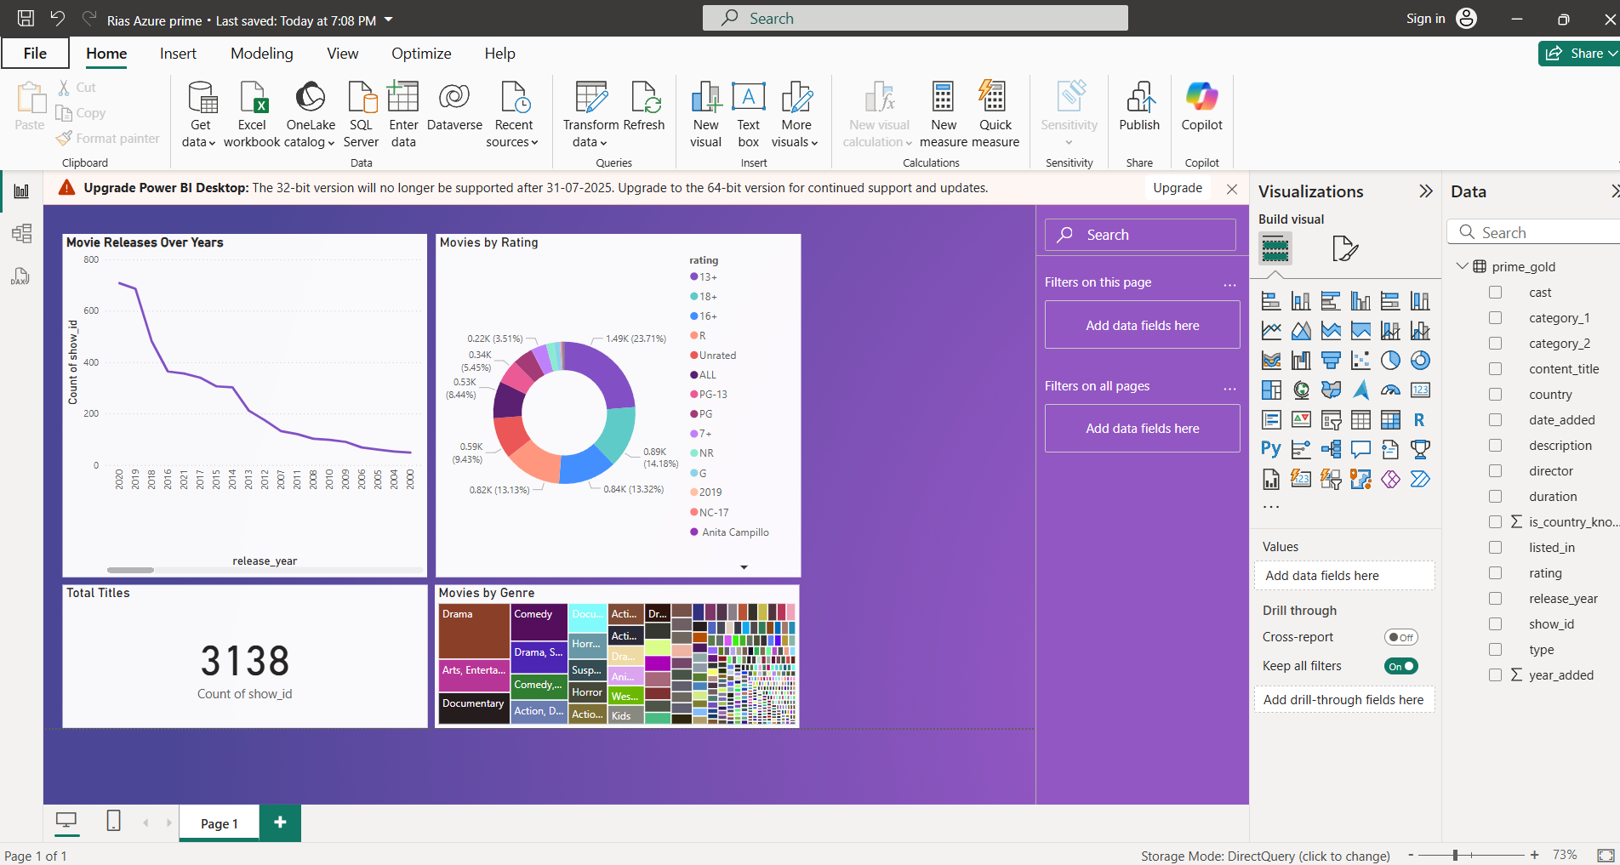
Step 9) Connecting ADB to Power BI and Generating Reports

Slide 19
Conclusion
This project demonstrates how to build a robust, scalable, and cloud-based ETL pipeline using modern Azure tools.
By integrating Azure Data Factory, Data Lake Storage, Databricks, and Power BI, we were able to:
Efficiently ingest, transform, and visualize data
Implement the Medallion Architecture for clean data layering
Provide business-ready insights through interactive dashboards
This end-to-end solution ensures faster decision-making, improved data management, and a strong foundation for enterprise-level analytics.

Slide 20
Thank you

